Slide 1
Attitudes to immigrants
Socio-tropic versus ego-tropic

Slide 2
Background
What causes anti-immigration attitudes?
Cultural or economic threat
I mainly focus on economic threat
Is it socio-tropic or ego-tropic

Slide 3
Theoretical Framework
Self-interest hypothesis
Unemployed individuals face direct labour-market competition → should be more sensitive to increases in immigrant share
Sociotropic threat hypothesis
Economic concerns are driven by national conditions, not personal experience → attitudes should not vary by individual unemployment history.
Jeannet (2018) finds becoming pensioner does not change attitudes
Individual versus socio-tropic (Hainmueller and Hopkins 2014; Cavaille and Marshall 2018)
Anti-immigrant attitudes due to unemployment is conditional on immigration numbers. Analysis is on country-level (Finseraas et al. 2016)

Slide 4
Research Question
Do individuals with unemployment experience respond more negatively to increases in local immigrant share?
Mirrors Finseraas et al. (2016) but on individual level
Also, the “immigrant share” factor is more complicated (Claassen and McLaren 2021)

Slide 5
Hypotheses
H1 (Main effect): Higher immigrant share increases economic concern (at least in the short run, though I do not test that).
H2 (Self-interest interaction): Individuals with (history of) unemployment show stronger negative reaction to higher immigrant share.
H3 (Alternative sociotropic prediction): Individual unemployment does not moderate effects; contextual economic indicators matter instead.

Slide 6
Data & Method
ESS rounds 5-11 (2010-2022)
Merged with country-year “foreign born share” (Eurostat)
Had to drop a few countries and rounds of ESS because of Eurostat data

Slide 7
Data & Method
Country and year fixed effects
Individual-level: age, education, nativity, gender
Dependent variable: imbgeco – “Immigrants are good for the economy.”
Key independent variables: imm_share, uemp3m (ever 3+ months unemployed), interaction term
Controls standardized

Slide 8
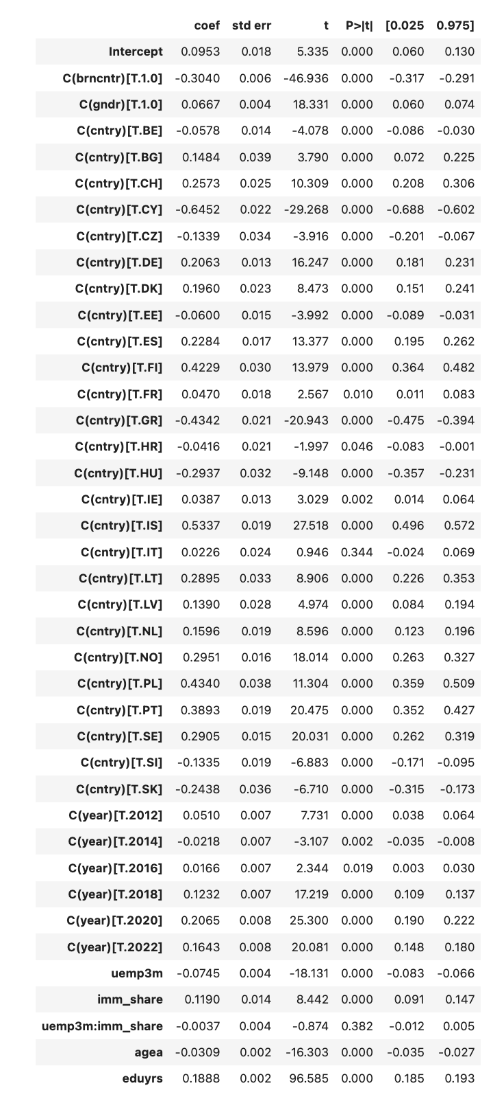
Results
Unemployment, immigration levels, age, education, nativism (a bit strange), and gender (0=female, 1=male) all statistically signigicant
However, interaction term not significant
Also, immigration levels term is positive. Probably reflects complicated temporal effects

Slide 9
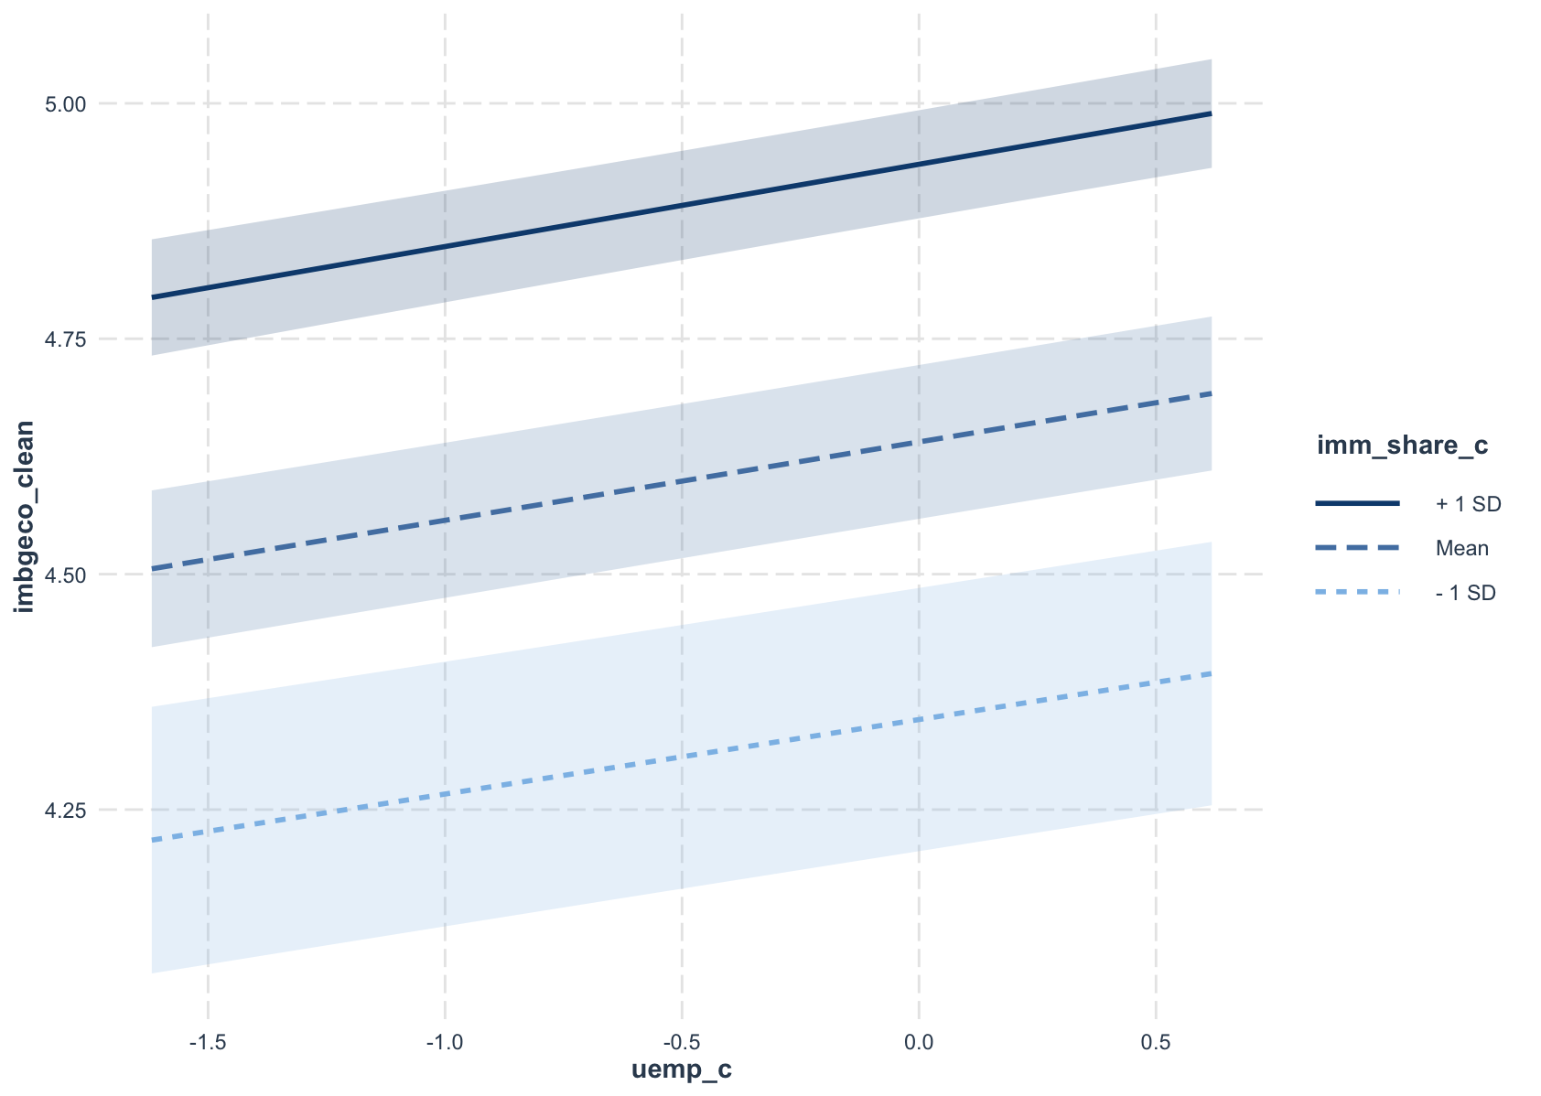
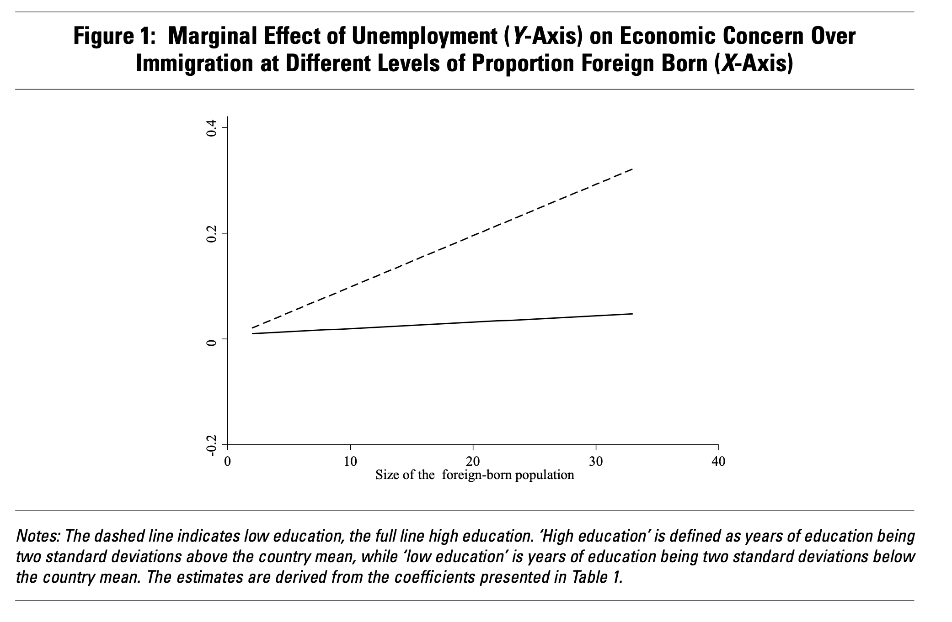
Marginal Effects
My regression
Finseraas et al. (2016)

Slide 10
Interpretation
Although individual level unemployment does cause anti-immigration
No evidence that this is increased by higher immigrant share
Supports socio-tropic interpretation of the effect that Finseraas et al. (2016) find
Individuals do not evaluate immigration based on their own job history

Slide 11
Robustness
I am sure there are many things wrong with my methodology
Personal unemployment is a poor proxy for subjective economic threat
Within-country variation in immigrant share may not be large enough or meaningful enough to trigger perceived labor-market competition

Slide 12
References
Finseraas et al. (2016)
Claassen and McLaren (2021)
Cavaille and Marshall (2018)
Jeannet (2018)
Laaker (2024)
Magni (2020)
Hainmueller and Hopkins (2014)

